Slide 1

l’Industria Aerospaziale
NELLA REGIONE CAMPANIA
a cura di Vincenzo Miano
SEMINARI INTERDISCIPLINARI DI CULTURA AERONAUTICA
II Ciclo – 1° incontro
23 maggio 2015
Prospettive del comparto aeronautico campano
Aula “S. Bobbio”, Scuola Politecnica e delle Scienze di Base – P.le Tecchio

Slide 2
iNTRODUCTION
200 ACTORS IN THE SECTOR: LARGE AND SMI, RESEARCH CENTER, LABORATORIES, CONSORTIA, ETC (5 Universities not included)
Approx 220 PLANTS IN THE REGION
25 COMPANIES HAVE HEADQUARTER OUT OF THE REGION
SIX CONSORTIA (ALI, Antares, CALTEC, CHAIN, Consaer, SAM) GROUP APPROX 70 COMPANIES
Data sources from website of:
Regione Campania
Campania Aerospace
Consortia
Single company

Slide 3
iNTRODUCTION
ALLOCATION (by Province)

Slide 4
iNTRODUCTION
ALLOCATION (by type)

Slide 5
iNTRODUCTION
ALLOCATION (by business name)

Slide 6
iNTRODUCTION
ALLOCATION (by establishment period)

Slide 7
Aerospace industry in campania today
ONE THE MOST IMPORTANT INDUSTRIAL SECTOR IN CAMPANIA
2011 data
■ Campania share

Slide 8

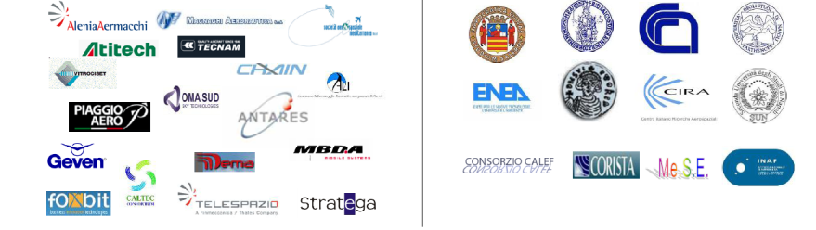
THE CAMPANIA Aerospace TECHNOLOGICAL DISTRICT
From May 30 2012: DAC – Distretto Tecnologico Aerospaziale della Campania establishment
  6 main companies
  128 SME
  11 research center
  €117 millions invested in 12 strategic research programs
Industrial partners
Research partners

Slide 9
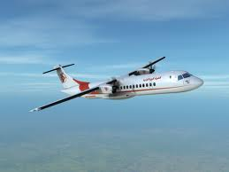
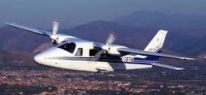
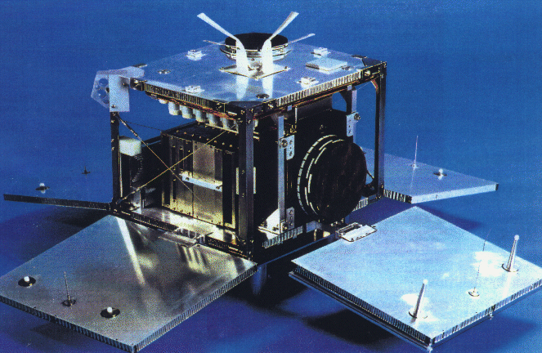

DEVELOPMENT LINES
Four main pillars identified:
COMMERCIAL AVIATION for the development of enabling technologies and technologies for the design and production of the new regional turboprop
GENERAL AVIATION for the development of manufacturing and assembly of light aircraft for Business & General Aviation
SPACE AND CARRIERS for the design and development of space platforms such as micro satellites and dual technologies related to carriers and systems for logistic and communications
MAINTENANCE AND TRASFORMATION for the development of new methodologies of maintenance and transformation

Slide 10


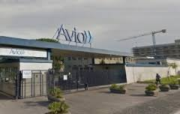
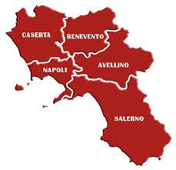
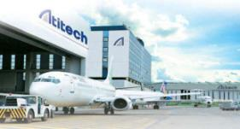


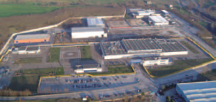
The main companies
Est. 1916
Aircraft main structures
3 plants: Pomigliano d’Arco (NA), Nola (NA), Capodichino (NA)
Approx 4000 employees
Est. 1939
Aero Engines Component Repair and Overhaul
Plant in Pomigliano d’Arco (NA)
Est. 1989
Aircraft MRO
Plant in Capodichino (NA)
Est. 1999
Engine components
Plant in Morra de Sanctis (AV)

Slide 11
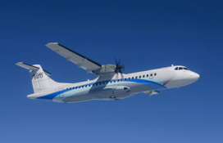


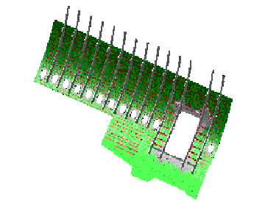
ALENIA AERMACCHI IN CAMPANIA
Pomigliano d’Arco plant
Nola plant
A T R
  Centre fuselage
  upper units
A380
Capodichino plant
Sold to ATITECH in 2015
  Centre-forward
  lower unit

Slide 12
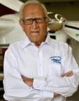






THE GENERAL AVIATION COMPANIES
From …to
Luigi Pascale
Napoli
Professor, aircraft designer
Est. 1948
Est. 1986
2 Plants in Capodichino (NA), Capua (CE)
Est. 1989
Plant in Capua (CE)
Est. 1996
Plant in Capodichino (NA)

Slide 13






Other main companies
Est. 1993
Aerostructure components
3 Plants in Somma Vesuviana (NA), Pomigliano d’Arco (NA), Paolisi (BN)
Est. 1989
Aerostructure components
2 Plants in Airola (BN), Acerra (NA)
Est. 1936
Landing gears and hydraulic systems
2 Plants in Naples, Arienzo (CE)
Est. 1984
Interiors
Plant in Nola (NA)
Est. 1920
Tools & Jigs
Plant in Pomigliano d’Arco (NA)
Est. 1973
Aerostructure components
2 plants: Cercola (NA), Cicerale (SA)

Slide 14
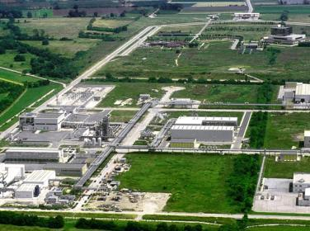
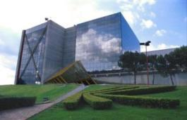

Cira - Centro Italiano di Ricerche Aerospaziali
Born in 1984 to manage PRORA, the Italian Aerospace Research Program
CIRA is a company with public and private sector shareholders

Slide 15
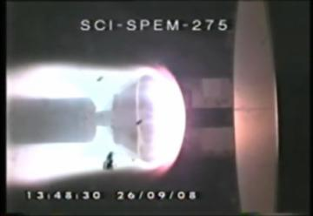
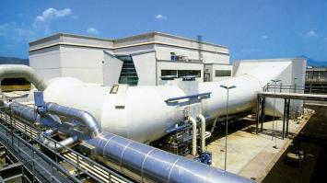
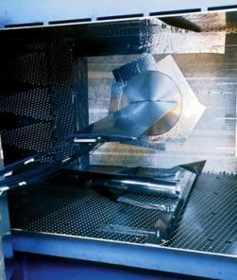
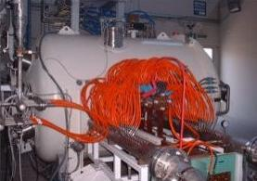
Cira - Centro Italiano di Ricerche Aerospaziali
Major facilities:
  Icing Wind Tunnel (IWT)
  Plasma Wind Tunnel (PWT)
  Aerospace Structures Impact Lab (LISA)
  PT1 Transonic Wind Tunnel
  GHIBLI hypersonic plasma tunnel
PWT
IWT
GHIBLI
PT1

Slide 16





Five UNIVERSITIES involved in aerospace research

Slide 17
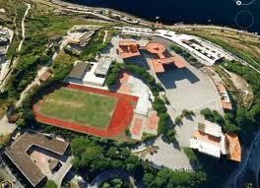
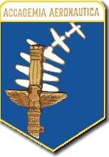
THE ITALIAN AIR FORCE ACADEMY
Established in Pozzuoli (NA) in 1961 to provide military and ethic education to Italian Air Force officials

Slide 18
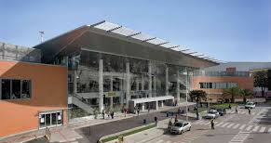

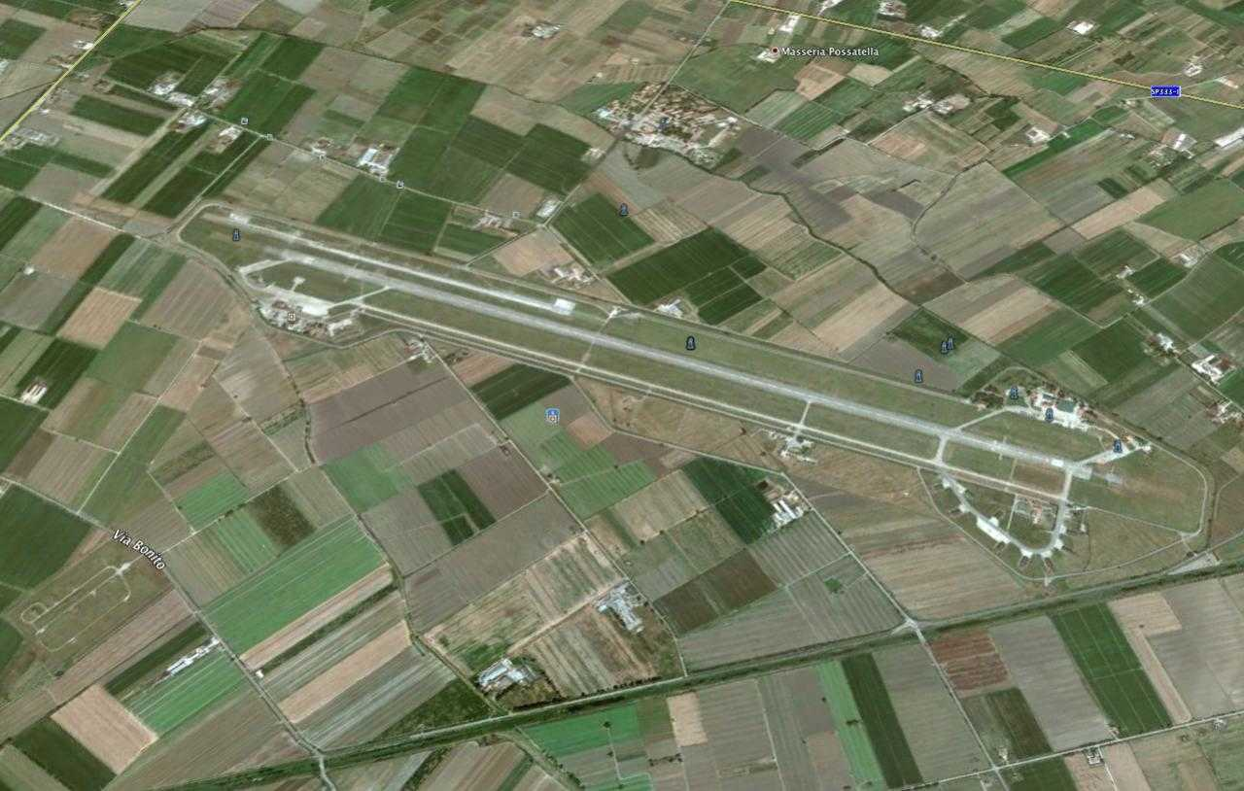
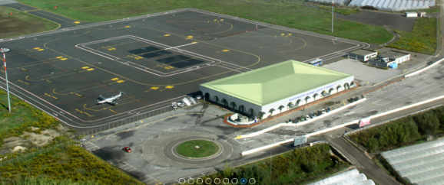
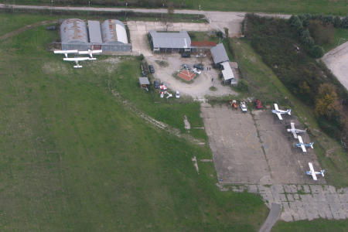

THE AIRPORT SYSTEM
Aeroporto di Grazzanise
“Carlo Romagnoli”
Aeroporto di Capua
“Oreste Salomone”

