Slide 1
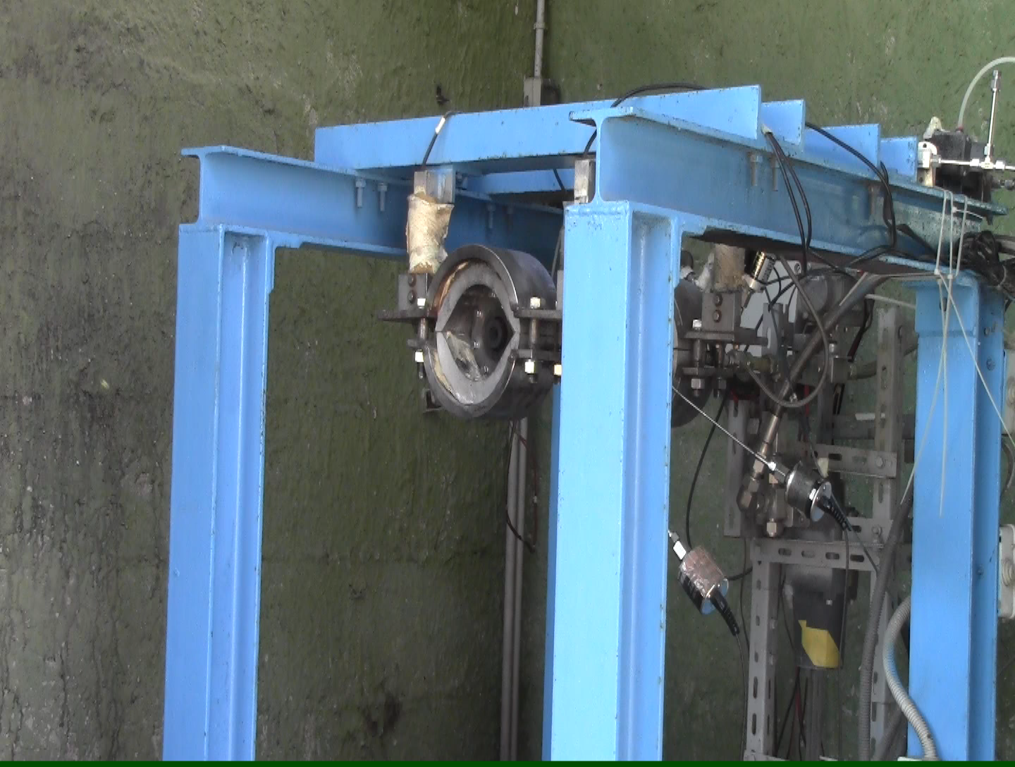
Hybrid Rocket Engines – Firing test
HDPE – 1
1

Slide 2
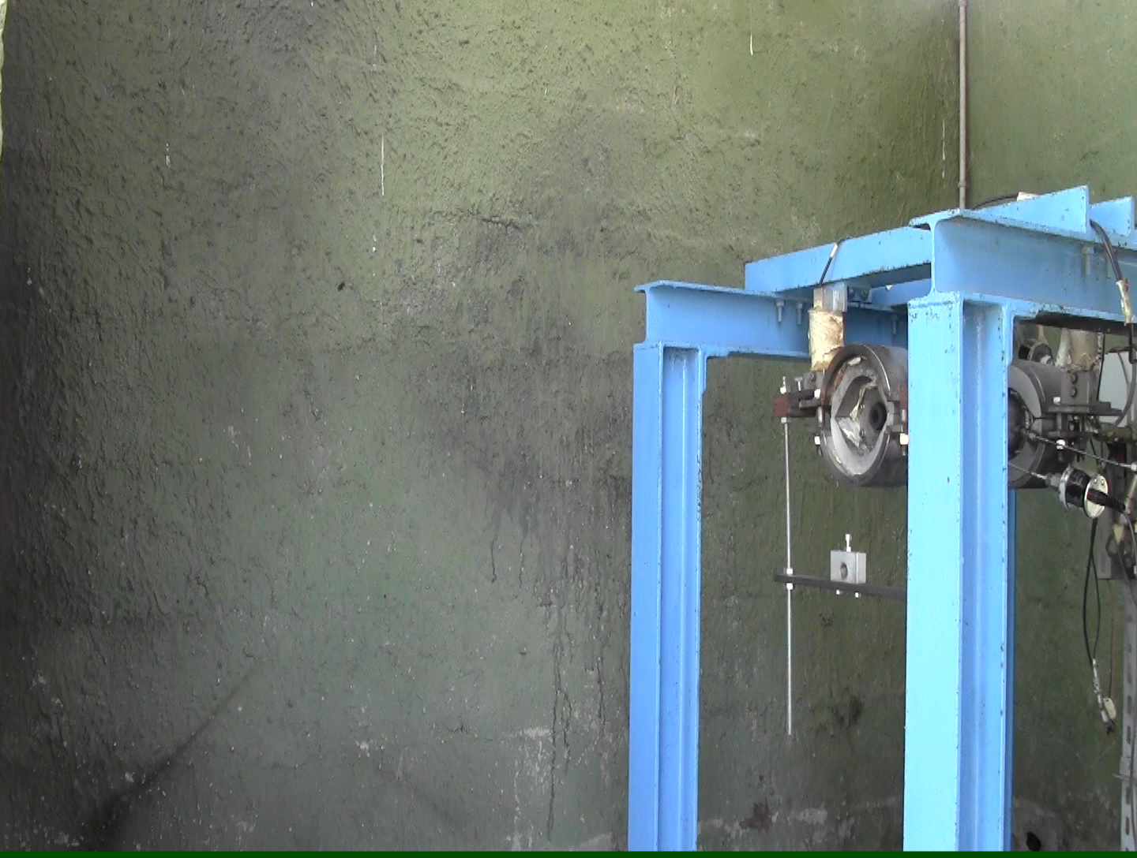
Hybrid Rocket Engines – Firing test
ABS – 1
2

Slide 3
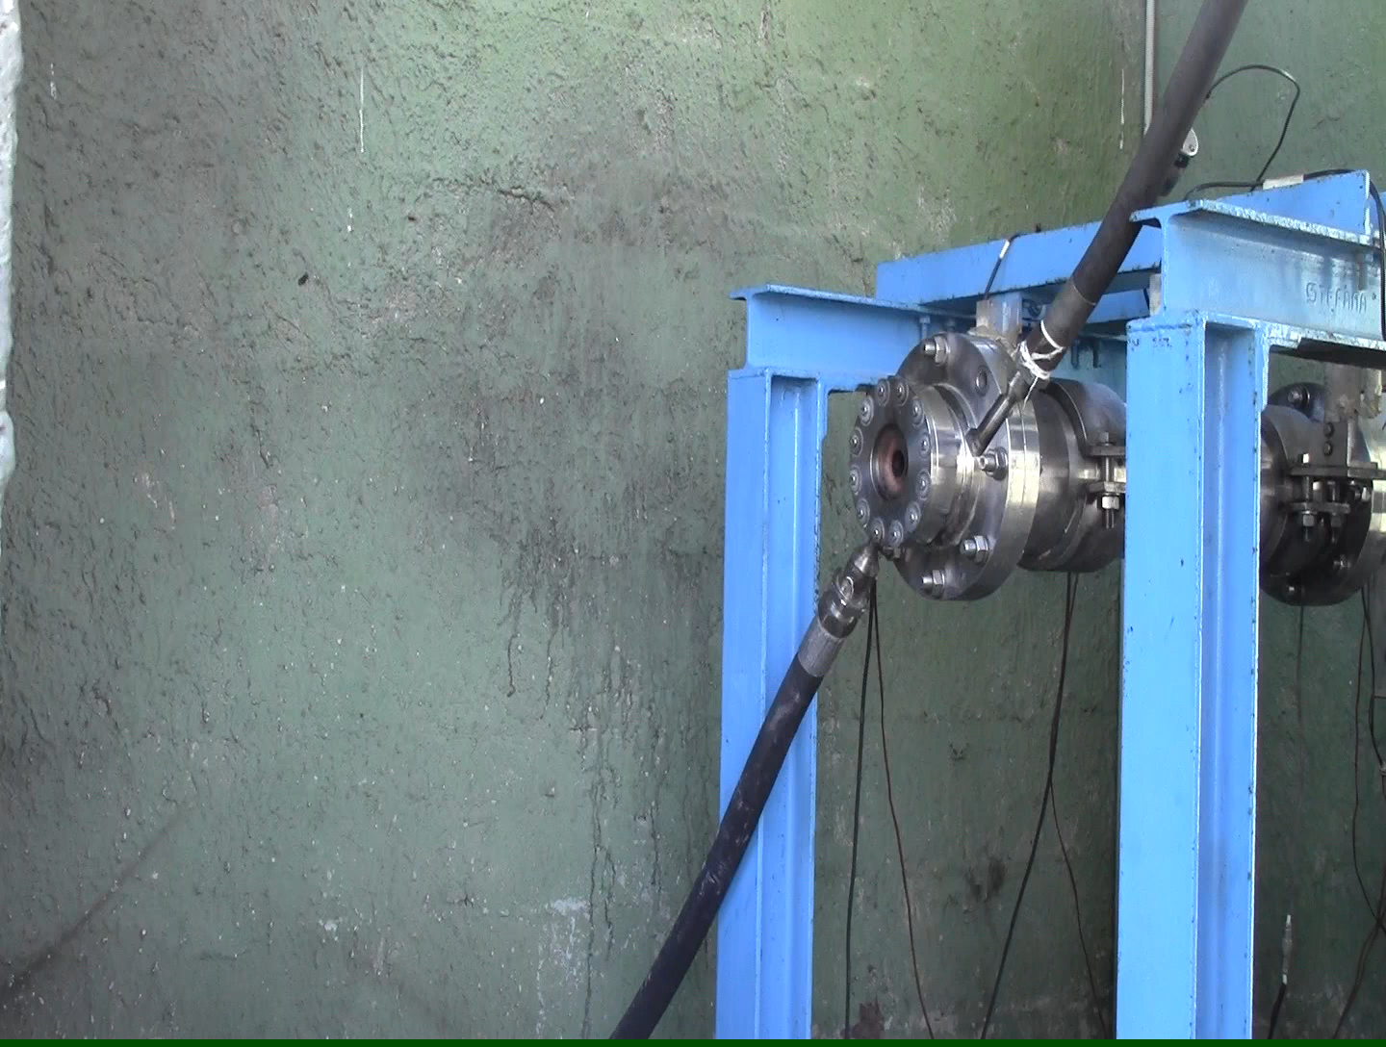
Hybrid Rocket Engines – Firing test
HDPE – 2
3

Slide 4
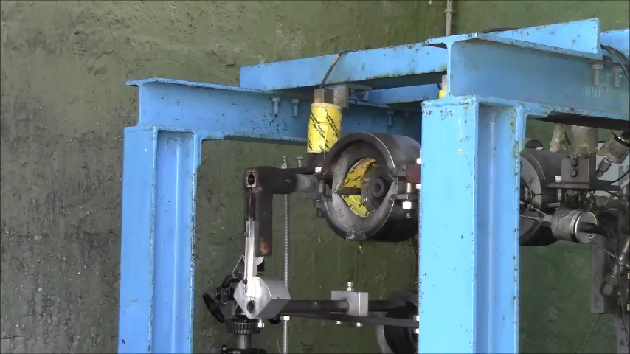
Free jet tests on UHTCMC samples
UHTCMC-FJ-1
4

Slide 5
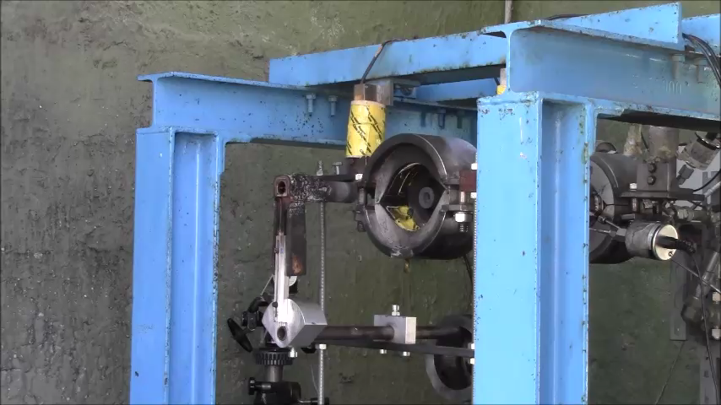
Free jet tests on UHTCMC samples
UHTCMC-FJ-2
5

Slide 6
Free jet tests on UHTCMC samples
UHTCMC-FJ-1
UHTCMC-FJ-2
6

