Slide 1
Deployable and Inflatable Structures: New Frontiers for Space Exploration, Astronomical Observation, and the Development of Advanced Technologies
Riccardo Augello
Mul2 Lab, Politecnico di Torino
HUMANS IN SPACE
8 Apr 2025
Scuola Politecnica e delle Scienze di Base – P.le Tecchio

Slide 2
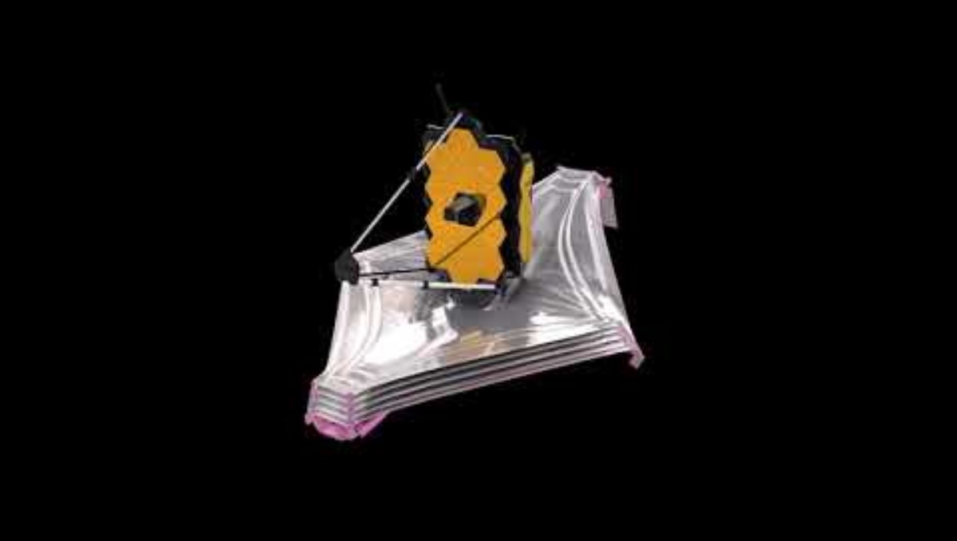
Mechanisms of Deployment: From Stowed to Operational
6

Slide 3
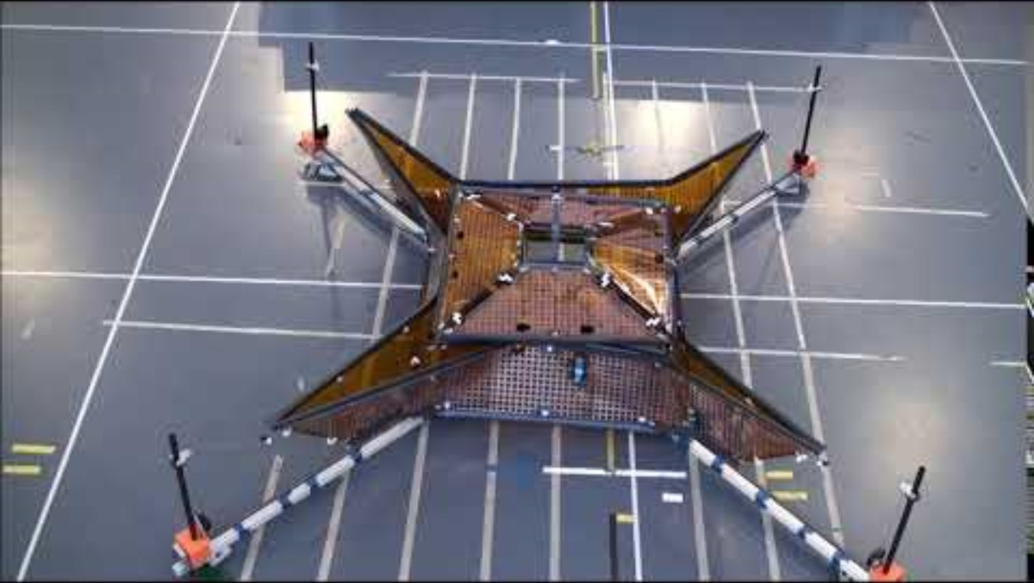
Validation & Testing: Ensuring Reliability Before Launch
13

Slide 4
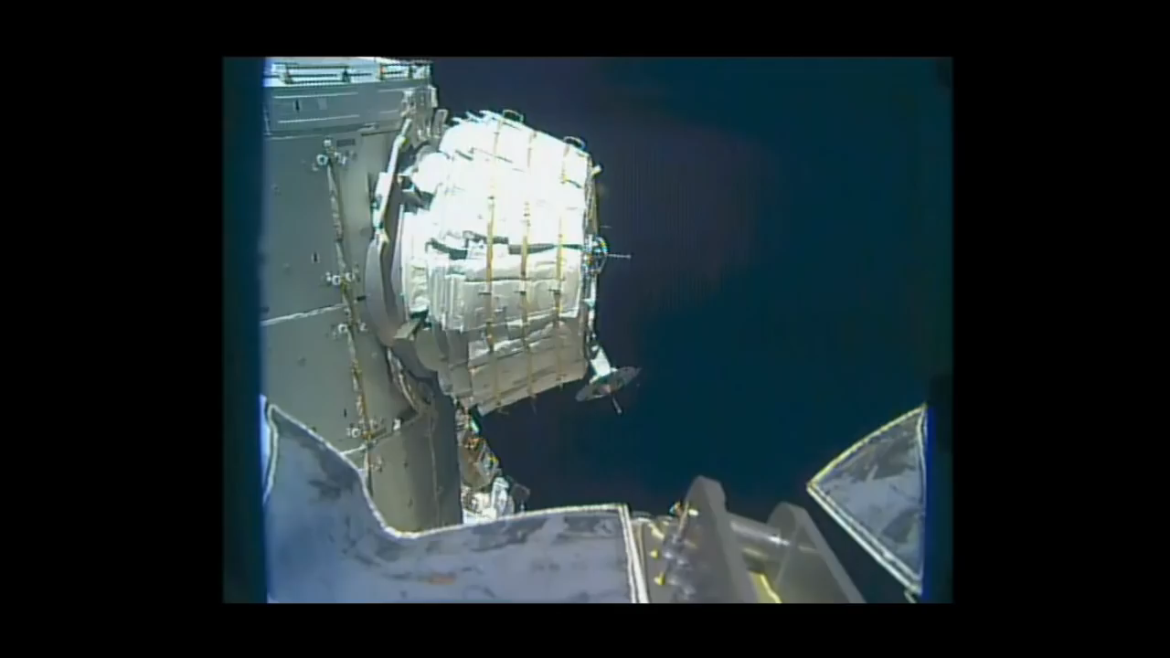
Case Study: Bigelow’s BEAM on the ISS
Credit: NASA TV
14

Slide 5
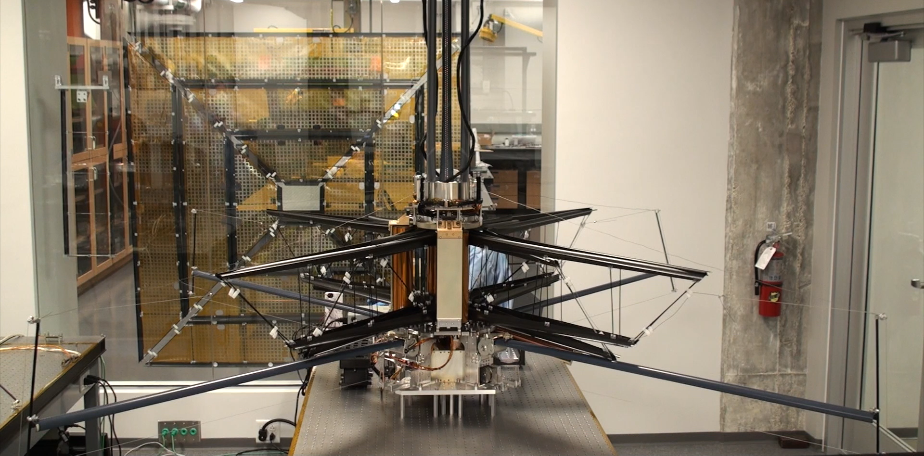
Space Solar Power Project – experimental deployment
19

Slide 6
Deployable and Inflatable Structures: New Frontiers for Space Exploration, Astronomical Observation, and the Development of Advanced Technologies
Riccardo Augello
Mul2 Lab, Politecnico di Torino
HUMANS IN SPACE
8 Apr 2025
Scuola Politecnica e delle Scienze di Base – P.le Tecchio

